Slide 1
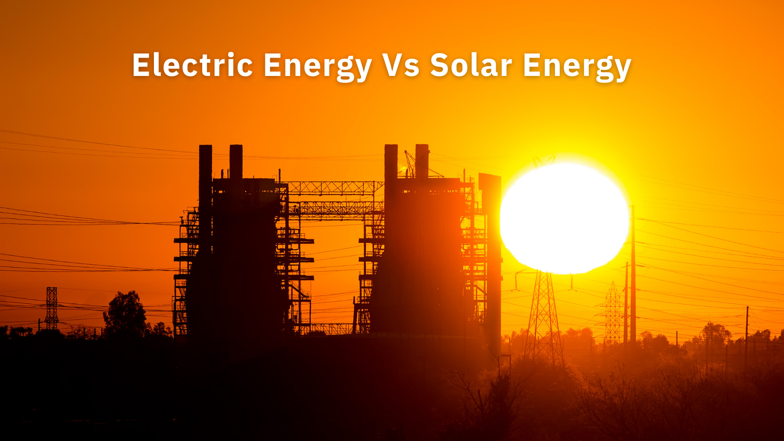
Information only.
Notes:
Now let's discuss the difference between electric energy and solar energy

Slide 2

How People Choose Their Electric Company
ELECTRIC COMPANY (A)
ELECTRIC COMPANY (B)
Monthly electric bill: $200 / mo
Bill increases with inflation, an average of 4% per year
Pay $92,748 in total electricity costs over 25 years (monthly payment in year 25 will be $513)
Pay your electric bill forever - until you die
Each payment makes the electric company richer
Your home value stays the same
Does not help your home sell faster
Receive no government tax credits
Electricity is created by turbine generators
Monthly electric bill: $200 / mo
Electric bill never increases – fixed payment
Pay $60,000 in total electricity costs over 25 years ($32,748 more than Company A)
Pay your electric bill up to 25 years & then own your energy
Each payment builds equity in your home
Your home value increases an average of 10%
Your home sells 20% faster & you can transfer the system
Qualify for 30% government tax credit: average $10,000+
Electricity is created by solar panels with the sun
If it was your choice… Company A or B?
Notes:
However, let’s say that when you first moved into your current neighborhood, there actually were two electric companies that you could have chosen.
Let’s call them electric company A and electric company B.
So, let’s do a quick review of the differences between electric company A and electric company B and then let’s see which company you would have chosen, if you had been given an option when you first moved in.
Electric company A has a monthly electric bill of $200 and electric company B also has a monthly electric bill of $200.
Now based on just this information, you could have chosen either electric company, isn’t that true?
However, let's further compare them and see which company starts to look more attractive.
With electric company A your bill increases with inflation an average of 4% per year and with electric company B your electric bill never increases, you have a fixed payment.
With electric company A you will pay over $92,748 in total electricity costs over 25 years, however with electric company B you will pay only $37,182 in total electricity costs over the next 25 years.
So now, which electric company is looking better to you? Obviously electric company B is.
Now let’s continue the comparison…
With electric company A you're going to pay your electric bill forever until you die but with electric Company B you're going to pay your electric bill up to 25 years and then you own your energy.
With electric company A each payment makes the electric company richer and with electric Company B each payment builds equity in your home.
With electric company A your home value stays the same but with electric Company B, according to government studies, your home value increases an average of 10%.
With electric company A it does not help your home sell faster but with electric Company B your home sells 20% faster and you can transfer the system to the new buyer.
With electric company A you receive no government tax credits but with electric Company B you can qualify for 30% government tax credits, averaging $10,000 plus.
Finally, with electric company A your electricity is created by turbine generators with coal, natural gas, is dirty energy and pollutes the environment, however with electric Company B your electricity is created by solar panels with the sun, is clean energy and helps protect the environment.
Based on these true facts and if you had been given a choice which electric company would you have chosen A or B?
So, can you see that it’s a pretty obvious choice for a homeowner to want to take advantage of all the benefits of solar energy?

Slide 3

LET’S LOOK AT YOUR ELECTRICITY COST
AVERAGE electric bill: $$
LOWEST bill: $
HIGHEST bill: $$$
Notes:
So just to show a real-life example to (trainee), about how much are your HIGHEST monthly electric bills during the year? (WFA) and about how much are your LOWEST monthly electric bills? (WFA) so if we average those out, your AVERAGE monthly bill is about $______ a month. Is that about right? (WFA)
Would you say your electric bill has gone down or up over the last 10 years? (WFA)
Now let’s just see about how much money you will end up paying for electricity over the next 10 years, without even adding in inflation or any annual increases.
Can you please open the calculator on your phone and multiply the average monthly amount you are currently paying of $______by 12 and see what amount you are paying for electricity per year. What annual amount do you get? (WFA)
Now we already know that rates will continue to increase, however just for simplicity, multiply $______ by ten and see the total amount that you will pay for electricity over the next 10 years, without the annual increases. What do you come up with? (WFA)
WOW! How do you feel about that number? (WFA) (look for their emotion)
Can you think of anything better that you’d rather spend $_________ dollars on, instead of your electric bill? (WFA)
So, let's just say, I gave you $______and you got to spend it on something fun or meaningful, what would you spend that money on? (WFA) How great would you feel? (DOING WHAT THEY WOULD SPEND THE MONEY ON) (WFA)
Instead of that, you’re just throwing that money away and giving it to the electric company, never to see it again.
So, if there was a way where you could’ve locked in your electric bill, whereby the electric company called you and said hey (homeowners), we have this new program, where you can lock in your bill for life, just sign here and your bill will stay at $_____per month and never go up, that would’ve been a pretty good program wouldn’t you agree? (WFA)
Can you imagine the tens of thousands of dollars you would save by having a lifetime locked in electric bill payment? (WFA)
So that’s one of the main reasons why millions of educated homeowners are taking advantage of solar energy because they lock in a fixed bill for life and then after their solar system is paid off, they will never have another bill, because sunshine is free. Doesn’t it make much better financial sense to keep all that money in your bank account, instead of giving to your electric company and making them even richer? (WFA)

Slide 4
Inflation Facts:
$100 at 5%: $121 in yr 5 $323 in yr 25
($57,288 vs $30,000 = $27,000 difference)
$200 at 5%: $243 in yr 5 $645 in yr 25
($114,516 vs $60,000 = $54,516 difference)
$300 at 5%: $466 in yr 5 $1,017 in yr 25
($179,076 vs $90,000 = $79,076 difference)
Notes:
So just to show a real-life example to (trainee), about how much are your HIGHEST monthly electric bills during the year? (WFA) and about how much are your LOWEST monthly electric bills? (WFA) so if we average those out, your AVERAGE monthly bill is about $______ a month. Is that about right? (WFA)
Would you say your electric bill has gone down or up over the last 10 years? (WFA)
Now let’s just see about how much money you will end up paying for electricity over the next 10 years, without even adding in inflation or any annual increases.
Can you please open the calculator on your phone and multiply the average monthly amount you are currently paying of $______by 12 and see what amount you are paying for electricity per year. What annual amount do you get? (WFA)
Now we already know that rates will continue to increase, however just for simplicity, multiply $______ by ten and see the total amount that you will pay for electricity over the next 10 years, without the annual increases. What do you come up with? (WFA)
WOW! How do you feel about that number? (WFA) (look for their emotion)
Can you think of anything better that you’d rather spend $_________ dollars on, instead of your electric bill? (WFA)
So, let's just say, I gave you $______and you got to spend it on something fun or meaningful, what would you spend that money on? (WFA) How great would you feel? (DOING WHAT THEY WOULD SPEND THE MONEY ON) (WFA)
Instead of that, you’re just throwing that money away and giving it to the electric company, never to see it again.
So, if there was a way where you could’ve locked in your electric bill, whereby the electric company called you and said hey (homeowners), we have this new program, where you can lock in your bill for life, just sign here and your bill will stay at $_____per month and never go up, that would’ve been a pretty good program wouldn’t you agree? (WFA)
Can you imagine the tens of thousands of dollars you would save by having a lifetime locked in electric bill payment? (WFA)
So that’s one of the main reasons why millions of educated homeowners are taking advantage of solar energy because they lock in a fixed bill for life and then after their solar system is paid off, they will never have another bill, because sunshine is free. Doesn’t it make much better financial sense to keep all that money in your bank account, instead of giving to your electric company and making them even richer? (WFA)

Slide 5
Any questions so far?
Notes:
Now that you know the true facts about solar, what do you like most about the benefits of solar energy? (WFA)
Anything else that you like? (WFA) Why is (WHAT THEY LIKED) important to you? (WFA)
By the way, before you owned your own home, did you ever just rent a home or an apartment? (WFA) So what were the main reasons why you decided to stop renting and achieved the American dream of home ownership? (WFA) Well those reasons of ownership, building equity and not throwing your money away in rent until the day you die, are the same exact reasons why homeowners choose to own their own solar system, because it builds equity in their home, and they are no longer throwing their money away to the electric companies. Does that make sense? (WFA)
So, this is why we take an educational approach in presenting solar energy, because once homeowners understand the true benefits of solar, most of them want to switch.
As a matter of fact, we have found that the only two reasons that homeowners don’t take advantage of solar energy, is either because they don’t understand the benefits of solar or because their homes don’t qualify, so do you understand everything so far? (WFA)

Slide 6
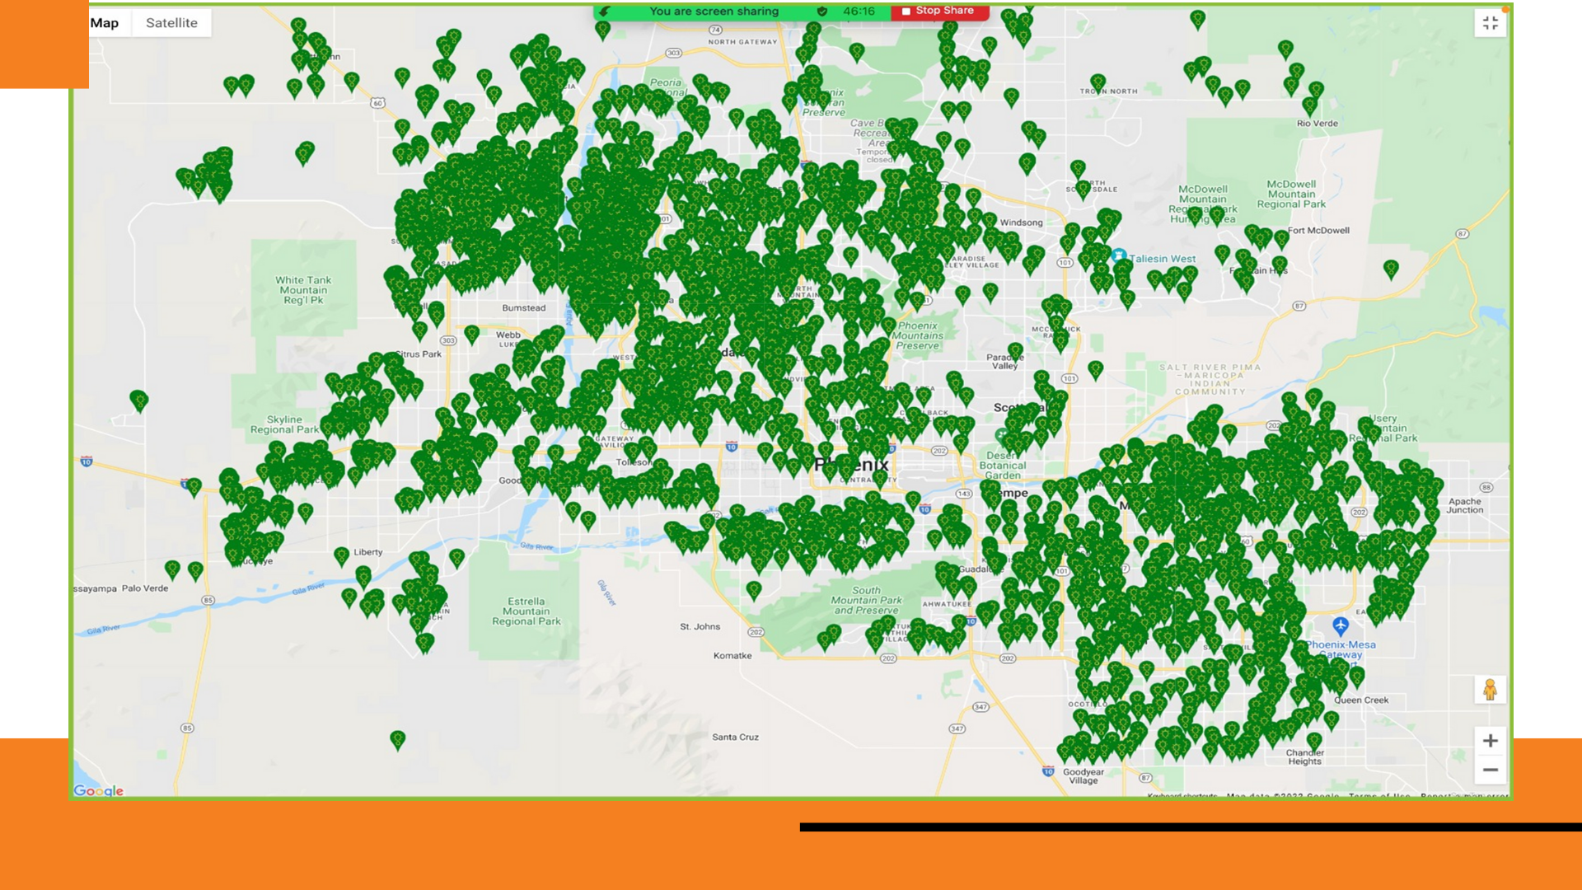

CLIENT TESTIMONIAL
HECTOR & MARIA PEREZ, ORLANDO FL.
$281.00
$149.00
OLD
ELECTRIC
BILL
NEW SOLAR BILL
INITIAL MONTHLY SAVINGS:
$132.00
If your electric company offered to put solar panels on your roof, guaranteed you the same amount of electricity you currently use, but for a lower fixed monthly payment & it saved you tens of thousands of dollars, would you be open to switching to solar energy?
*30YR ELECTRICITY SAVINGS.....$97,159
*10% HOME VALUE INCREASE…$45,228
*30% GOV’T TAX CREDIT...........$13,846
TOTAL FINANCIAL BENEFIT = $156,233
*30 YR SAVINGS BASED ON 4% AVERAGE INFLATION INCREASES
*10% AVERAGE HOME APPRECIATION BASED ON GOV’T STUDY
*30% TAX CREDIT BASED ON SYSTEM COST & QUALIFYING, PER IRS
Notes:
Here is one of our happy clients, Hector and Maria Perez. We did a free customized energy savings analysis for them, and they wisely switched to solar energy with zero out of pocket costs. The reason they switched to solar, is because they went from an old $281 a month electric bill, to a new solar bill of $149 a month. So now they are paying a lower fixed solar payment of only $149 a month for their solar system, that will never increase, they own it, it provides the amount of electricity that they need, and they have completely eliminated their electricity usage bill. In other words, they will NOT have two electricity usage bills. They will only have one solar system bill.
Then as you already know, their old electric bill would’ve been increasing with inflation, at least 4% a year, while their new solar bill is a fixed payment that will never go up. That’s why when we plug this data into our energy savings calculator, as the old electric bill would continue going up by 4% a year, the new solar bill stays fixed and…
(CLICK PPT) Over 30 years, that difference works out to be a true electricity savings of $97,159 that they now get to keep in their bank account.
Then according to the US energy dept. study that we showed you, they will get an average 10% home value increase, whereby they will also enjoy another $45,228 in financial benefits. Finally, they qualified for a 30% government tax credit which equates to another $13,846 in benefits and that totals out to be a summary financial benefit of $156, 233 by simply switching to solar energy and owning their own solar system….that’s pretty powerful isn’t it? (WFA)
(CLOSING QUESTION) (CLICK PPT)
So, If your electric company offered to put solar panels on your roof, guaranteed you the same amount of electricity you currently use, but for a lower fixed monthly payment and it saved you tens of thousands of dollars, would you switch to solar energy? (WFA) However, would your electric company ever do that for you? (WFA) Why not? (WFA) (reaffirm their answer)
(ONLY IF THEY ARE HESITANT OR SAY NO - DO REVERSE CLOSE) ok I understand how you feel. However, what if you already had solar panels on your roof and a representative from your local electric company knocked on your door and said…Hi (homeowners) I see you have these beautiful solar panels on your roof and that you're paying a fixed bill of only $149 a month, that never goes up. I would love to have my crew remove your panels, put you on our electric grid and raise your payment up to $281 a month and we can legally increase your electric bill 5-8% every year. Also, you will end up paying our electric company over $97,000 more in electricity costs over the next 30 years, you will lose your $45,000 home value increase and you’ll have to give back your $13,000 tax credit to the IRS. (homeowners) Knowing what you know now, would you allow your electric company to take those valuable financial benefits away from you? (WFA) Great, so what your truly saying is that saving money with your own solar system makes much better financial sense, doesn’t it? (WFA)

Slide 7
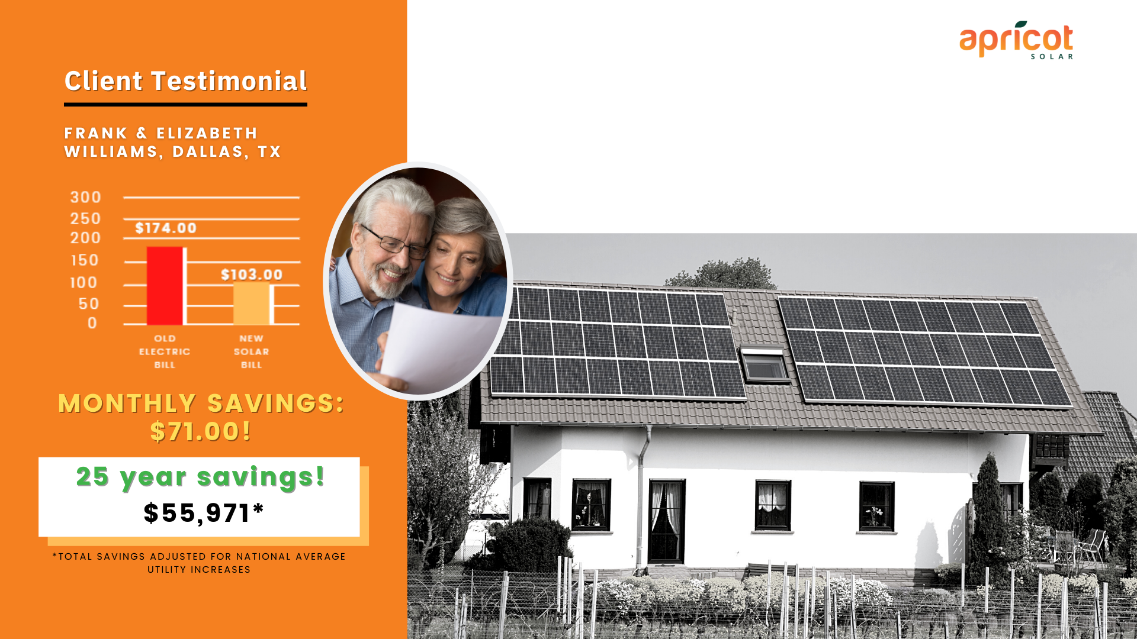

If after completing an energy savings analysis, your fixed solar payment is temporarily a bit higher, but like this family, you still saved over $50,000 and increased your home value with no money out of pocket, would you agree that switching to solar would still be worth it?
CLIENT TESTIMONIAL
FRANK & ELIZABETH WILLIAMS, DALLAS TX.
$194.00
$164.00
OLD ELECTRIC BILL
NEW SOLAR BILL
INITIAL MONTHLY SAVINGS:
$0 ($199.34 in Yr 5 @ 5%)
*30YR ELECTRICITY SAVINGS…..$59,304
*10% HOME VALUE INCREASE...$28,942
*30% GOV'T TAX CREDIT...........$16,189
TOTAL FINANCIAL BENEFIT = $104,435
25 year savings! $55,971*
*30 YR SAVINGS BASED ON 4% AVERAGE INFLATION INCREASES
*10% AVERAGE HOME APPRECIATION BASED ON GOV’T STUDY
*30% TAX CREDIT BASED ON SYSTEM COST & QUALIFYING, PER IRS
Notes:
Now here is another happy client named Frank and Elizabeth Williams. There situation was a bit different and not normal. After completing their energy savings analysis, their energy bill actually went up from $164 per month to $194 per month. However, although their solar payment was $30 more per month, remember that it is a locked in payment that will never go up, while the $164 per month electric bill will continue to go up with inflation and annual increases. So, although there was zero initial monthly savings, let's look at their overall financial benefit. (CLICK PPT) Over a 30-year period, they will still enjoy electricity savings of $59,304. Their home value increased by $28,942 and they got a government tax credit of $16,189. This is a total financial benefit of over $104,000. Just to be clear and to summarize, remember that although their solar payment was a bit higher in the beginning, it is a fixed payment and does not continually go up like their electric bill. That's why their overall true savings is still over $50,000. Wouldn't it be nice to have an extra $50,000 in your bank account versus giving it to the electric company? (WFA)
(CLOSING QUESTION)
So, if after completing an energy savings analysis, your fixed solar payment is temporarily a bit higher, but like this family, you still saved over $50,000 and increased your home value with no money out of pocket, would you agree that switching to solar would still be worth it? (WFA)

Slide 8
TOP 5 Considerations
Before Going Solar
Notes:
(CLICK PPT) So, do you have any questions or concerns about solar energy? (WFA) If we can get you a fixed monthly electric bill and save you tens of thousands of dollars, would that help you? (WFA) Now after learning about all the financial benefits of solar energy, most financially wise homeowners want to immediately switch to solar and start saving money, however….

Slide 9
Top 5 Things to Look At Before Moving On Solar
COST Up front out of pocket cost
Total Equipment Cost
Notes:
(CLICK PPT) So, do you have any questions or concerns about solar energy? (WFA) If we can get you a fixed monthly electric bill and save you tens of thousands of dollars, would that help you? (WFA) Now after learning about all the financial benefits of solar energy, most financially wise homeowners want to immediately switch to solar and start saving money, however….

Slide 10
Top 5 Things to Look At Before Moving On Solar
COST Up front out of pocket cost
Total Equipment Cost
ROOF Site Survey will tell us if work is needed
Rolls into the total program if any work is needed
Notes:
(CLICK PPT) So, do you have any questions or concerns about solar energy? (WFA) If we can get you a fixed monthly electric bill and save you tens of thousands of dollars, would that help you? (WFA) Now after learning about all the financial benefits of solar energy, most financially wise homeowners want to immediately switch to solar and start saving money, however….

Slide 11
Top 5 Things to Look At Before Moving On Solar
COST Up front out of pocket cost
Total Equipment Cost
ROOF Site Survey will tell us if work is needed
Rolls into the total program if any work is needed
MOVING Solar Equipment loan can transfer to new owner
Buyer can add into the mortgage and cash out
Can add 10% to 15% to your home value
Notes:
(CLICK PPT) So, do you have any questions or concerns about solar energy? (WFA) If we can get you a fixed monthly electric bill and save you tens of thousands of dollars, would that help you? (WFA) Now after learning about all the financial benefits of solar energy, most financially wise homeowners want to immediately switch to solar and start saving money, however….

Slide 12
Top 5 Things to Look At Before Moving On Solar
COST Up front out of pocket cost
Total Equipment Cost
ROOF Site Survey will tell us if work is needed
Rolls into the total program if any work is needed
MOVING Solar Equipment loan can transfer to new owner
Buyer can add into the mortgage and cash out
Can add 10% to 15% to your home value
SERVICE Our Installer monitors your system 24/7 and has a 25 yr
Power Production Guarantee. If there are any issues they catch and fix it.
Notes:
(CLICK PPT) So, do you have any questions or concerns about solar energy? (WFA) If we can get you a fixed monthly electric bill and save you tens of thousands of dollars, would that help you? (WFA) Now after learning about all the financial benefits of solar energy, most financially wise homeowners want to immediately switch to solar and start saving money, however….

Slide 13
Top 5 Things to Look At Before Moving On Solar
COST Up front out of pocket cost
Total Equipment Cost
ROOF Site Survey will tell us if work is needed
Rolls into the total program if any work is needed
MOVING Solar Equipment loan can transfer to new owner
Buyer can add into the mortgage and cash out
Can add 10% to 15% to your home value
SERVICE Our Installer Freedom Forever monitors your system 24/7
If there are any issues they catch and fix for 25 years
SAVINGS To see what that can be ... we’ll just need YOUR BILL
Notes:
(CLICK PPT) So, do you have any questions or concerns about solar energy? (WFA) If we can get you a fixed monthly electric bill and save you tens of thousands of dollars, would that help you? (WFA) Now after learning about all the financial benefits of solar energy, most financially wise homeowners want to immediately switch to solar and start saving money, however….

Slide 14
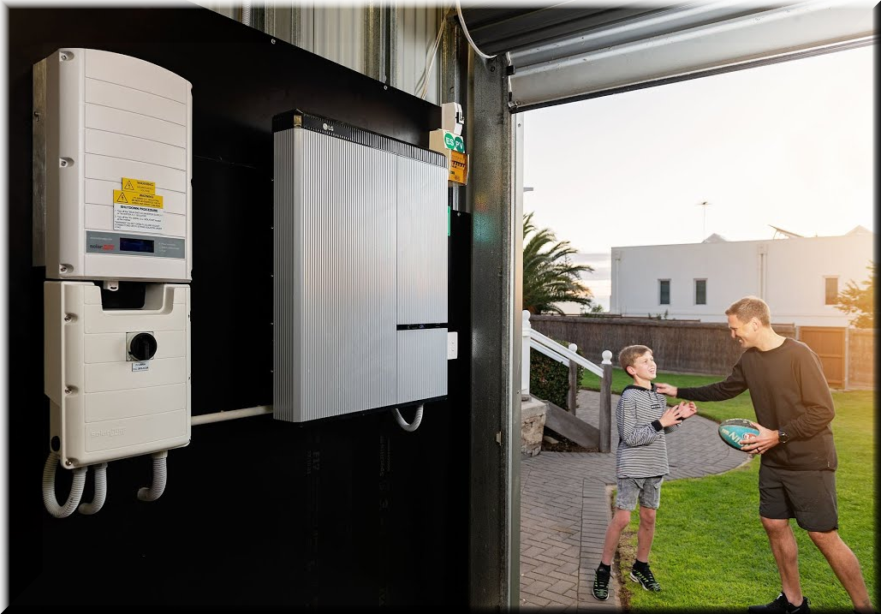
BONUS! We will take a look at ALL YOUR SOLAR BENEFITS
Our job is to SHOW YOU what you can do.
TOTAL BLACK OUT PROTECTION
STAY OFF GRID AS LONG AS YOU WANT
SELL ELECTRICITY BACK TO THE GRID
MONITOR YOUR SYSTEM 24/7 YOURSELF
SAVINGS BY LOCKING IN YOUR RATE
Notes:
(CLICK PPT) So, do you have any questions or concerns about solar energy? (WFA) If we can get you a fixed monthly electric bill and save you tens of thousands of dollars, would that help you? (WFA) Now after learning about all the financial benefits of solar energy, most financially wise homeowners want to immediately switch to solar and start saving money, however….

Slide 15
The 3 Factors That Determine If Your Home Qualifies…
1
2
3
Available Funding for Your Home
Home Site
Survey
The Installers have
“Last Say”
Have many custom programs available
ZERO out of pocket costs
Roof – Trees – Electrical upgrading
Anything needing to
be addressed for installation.
Most can be rolled into the Solar Loan.
Due to the long term commitment of their 25-year Power Production Guarantee, they have final approval.
Notes:
Now here are the 3 factors that actually determine if your home qualifies for solar…
(CLICK PPT) Number 1… If you are financing, then the available funding for your home. The great news is that we have many custom programs available, and the best part is that there are zero out of pocket costs to you. (CLICK PPT) Number 2 is a home site survey. This is where we send out an engineer with a professional crew to look at your roof type and its condition, to determine if it qualifies for solar or if the roof needs to be repaired. A great thing is that if your roof does need to be repaired, you can use your own roofer or we can refer you to one of our top licensed roofers and include that roof repair into your monthly solar payment, also with no money out of your pocket. And then the third factor (CLICK PPT) and probably the most important is Freedom Forever. Due to the high liability and cost of their exclusive 25-year electricity production guarantee, they are very selective as to the homes that they will approve.
So, let’s say you owned a top solar company, and you were guaranteeing homeowners their electricity production for 25 years, wouldn’t you be very careful as to the solar projects that you approve? (WFA)
Yes, and now you understand why Freedom Forever is so selective in qualifying a home for solar.

Slide 16
If Going Solar can save you…
Tens of thousands of dollars in electricity costs
Do it with no money out of pocket
Add value to your home
Give your Electric Bill an END DATE
Would you like a free energy savings analysis?
Notes:
(CLICK PPT) So, do you have any questions or concerns about solar energy? (WFA) If we can get you a fixed monthly electric bill and save you tens of thousands of dollars, would that help you? (WFA) Now after learning about all the financial benefits of solar energy, most financially wise homeowners want to immediately switch to solar and start saving money, however….

Slide 17
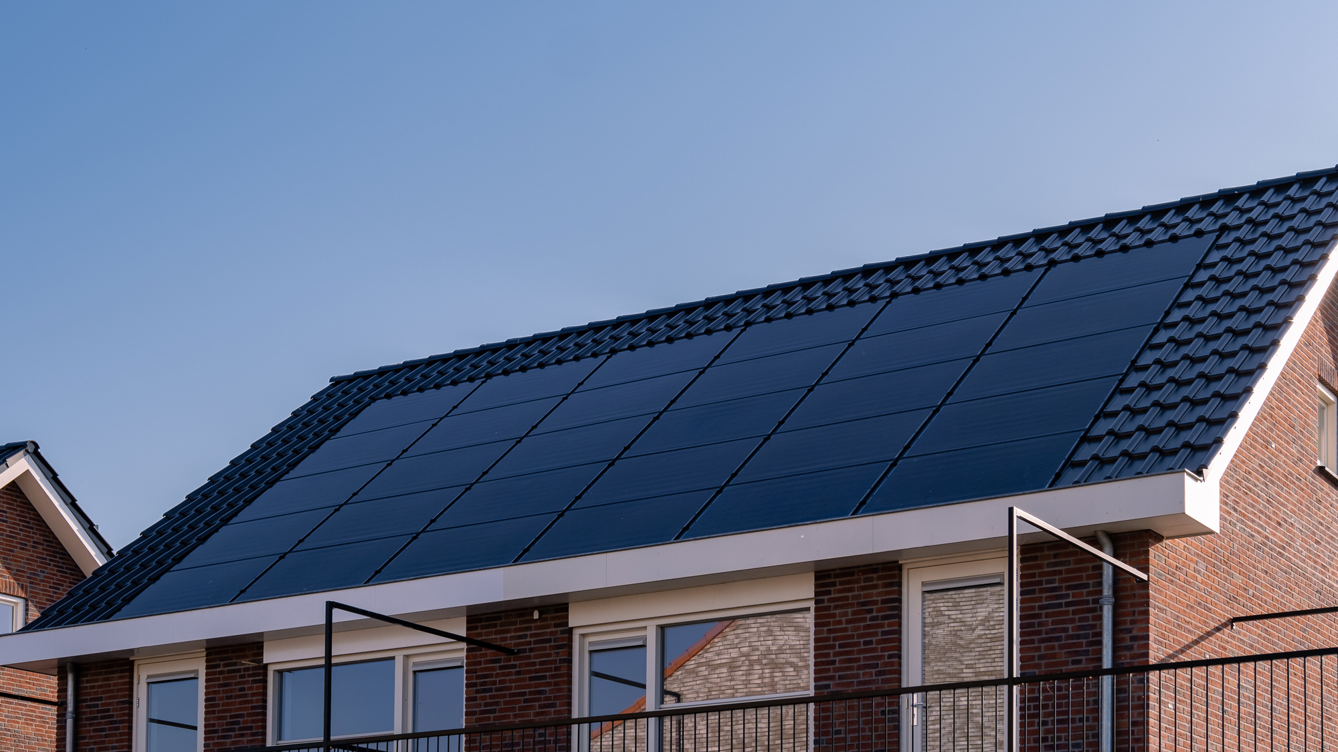

YOUR NEXT STEPS
Text or email a copy of your electric bill
(including the 12 month energy usage graph)
We will prepare a free energy savings analysis:
See how much money you will save
See much your home value will increase
The federal, state and local tax incentives that are available to you
Ask a few questions to see which funding programs are available
Follow-up appointment date:____________ Time:____________
Notes:
Great, here are the next steps… (CLICK & READ PPT) Text or email your electric bill to (trainee) (including the 12-month energy usage graph and a picture of the inside of your electrical panel box).
So that we can prepare an accurate energy savings analysis, can you please just grab your bill now and take a quick photo of the front and back of your bill and send it to (trainee)? (WFA) Then also send us a photo of the inside of your electrical box.
How soon can we get a copy of your electric bill and a photo of your electrical panel box? (WFA) Also what is your best email and cell phone number? (WFA)
(CLICK & CONTINUE SHOWING PPT)
(CLOSING QUESTION) (homeowners) If we provide you a fixed monthly electric bill and save you tens of thousands of dollars, with zero out of pocket costs, will you take advantage of solar energy if you and your home can qualify? (WFA)
(MUST GET A FIRM YES COMMITMENT or do the REVERSE CLOSE from the first client success story)

